Slide 1
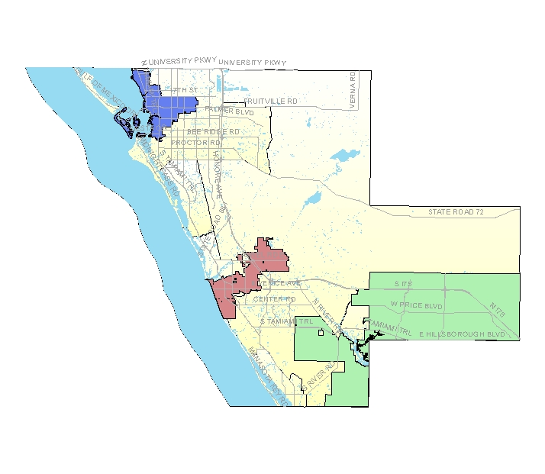
Community Data 2.0
Review of Past Community Efforts
Hosted by SCOPE
May 19, 2011
Gulf Coast Event & Conference Center
Sarasota, Florida

Slide 2
Summary of SCOPE-related efforts
6 Community Report Cards
(Demographics)
Civic Participation
Culture & Recreation
Economy
Health
Learning
Natural Environment
(Built Environment)
Social Environment
Transportation
8 Study Reports
Aging: The Possibilities (2009)
Race & Cultural Relations (2008)
Community Change:
Redevelopment & Infill (2004)
Family Violence (2004)
Mental Health (2003)
School Dropout (2003)
Affordable Housing (2002)
Traffic Flow & Congestion (2002)
2 People Count Reports
People Count
People Count: Race & Ethnicity

Slide 3
Summary of Community Indicators
Domain | # of indicators
Demographics | 12
Civic Participation | 17
Culture & Recreation | 9
Economy | 30
Health | 30
Learning | 21
Natural Environment | 15
Built Environment | 5
Social Environment | 27
Transportation | 18
184

Slide 4
Other Community Efforts
Community Health Improvement Partnership
Economic Development Corporation
Sarasota County Green Map
Community Alliance
PACE-EH
Continuing the Conversation

Slide 5
Advisory Groups: Longboat Key
PZB Board
Zoning Board of Adjustment
Code Enforcement Board
Police Officers Pension Board
General Employees Pension Board
Firefighters Pension Board
Citizens Tax Oversight Committee

Slide 6
Advisory Groups: North Port
Art Advisory Board
Audit Committee
Beautification and Tree/Scenic Highway Committee
Business and Economic Development Advisory Board
Charter Review Advisory Board
Citizens Tax Oversight Committee
Code Enforcement Board
Contractor's Licensing Board
Joint Management Advisory Board
Loan Administration Committee
Municipal Firefighters Pension Trust Fund Board of Trustees
Municipal Police Officers' Pension Trust Fund Board of Trustees
Naming Committee
Parks & Recreation Advisory Board
Planning & Zoning Advisory Board
Public Utility Advisory Board
Sister City Committee
Tamiami Trail Appearance Advisory Board
Transportation Advisory Board
Zoning Board of Appeals

Slide 7
Advisory Groups: Venice
Architectural Review Board
Municipal Code Enforcement Board
Construction Board of Adjustment & Appeals
Economic Development Task Force
Environmental Task Force
Fire Pension Board
Historic Preservation Board
Parks & Recreation Advisory Board
Planning Commission
Police Pension Board
Public Art Task Force
Citizen Tax Oversight Committee
Venice Housing Authority

Slide 8
Advisory Groups: Sarasota
Board of Adjustment
Bobby Jones Golf Course Advisory Board
Building and Fire Board of Rules and Appeals
Charter Review Committee
Citizen Tax Oversight Committee
Citizens with Disabilities Advisory Board
Civil Service / General Personnel Board
Community Redevelopment Agency Advisory Board
Downtown Improvement District Board of Directors
Historic Preservation Board
Human Relations Board
Newtown Community Redevelopment Agency Advisory Board
Nuisance Abatement Board
Parks, Recreation, and Environmental Protection Advisory Board
Planning Board / Local Planning Agency
Police Advisory Panel
Police Complaint Committee
Public Art Committee
Sarasota Housing Authority Board of Directors
St. Armand's Business Improvement District Board of Directors
Van Wezel Performing Arts Hall Board
Youth Advisory Board

Slide 9
Advisory Groups: Sarasota County
Animal Welfare Advisory Council (AWAC)
Bicycle/Pedestrian/Trail Advisory Committee
Board of Zoning Appeals
Building Code Board of Adjustments & Appeals
Citizen Tax Oversight Committee
Citizens Advisory Committee for Public Transportation
Coastal Advisory Committee
Community Action Agency Board
Development Services Advisory Committee
Emergency Medical Services Advisory Board
Englewood Community Redevelopment Area Advisory Bd
Environmental Policy Task Force
Environmentally Sensitive Lands Oversight Committee
Fire Rescue District Advisory Board
General Contractors Licensing & Examining Board
Health Planning Council of SW Florida
Historic Preservation Board
Historical Commission
Human Services Advisory Council
Integrated Pest Management Advisory Board
Keep Sarasota County Beautiful Advisory Board
Library Advisory Board
Mechanical Contractors Licensing & Examining Board
Metropolitan Planning Organization Citizens' Advisory Committee
Neighborhood Initiative Grant Advisory Committee
Nokomis Revitalization Advisory Committee
Parks Advisory and Recreation Council
Planning Commission
Public Facilities Financing Advisory Board
Sarasota County Health Facilities Authority and Industrial Development Revenue Bond Citizens Advisory Committee
Sarasota Tree Advisory Council
Seniors Advisory Council
SHIP Affordable Housing Advisory Committee
Stormwater Environmental Utility Advisory Committee
Tourism and Economic Development Board (TEDB)
Tourist Development Council
Traffic Advisory Council
Water and Sewer Advisory Council
Waterways Advisory Council
Well Drilling Advisory Board

Slide 10
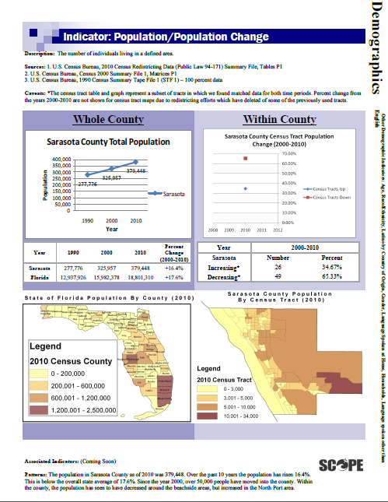
2010 Update

Slide 11
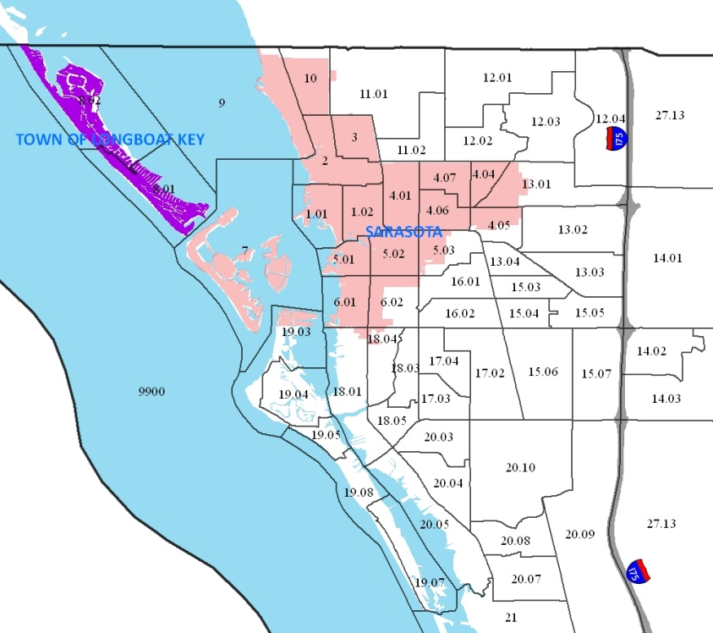
2010 Update – Census Tracts map

Slide 12
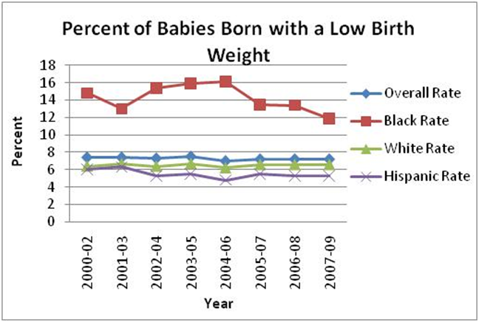
2010 Update – Low Birth Weight

Slide 13
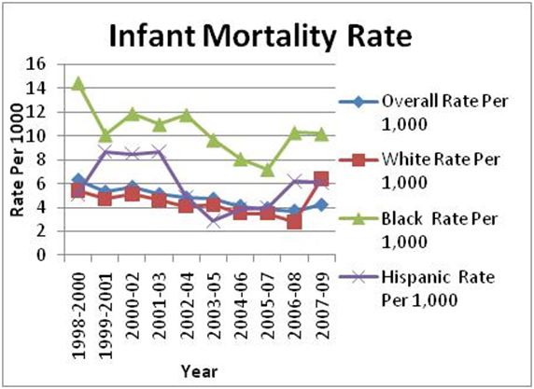
2010 Update – Infant Mortality

Slide 14
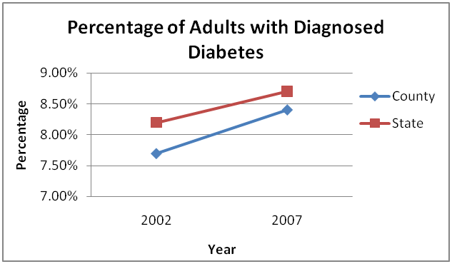
2010 Update – Diabetes

Slide 15
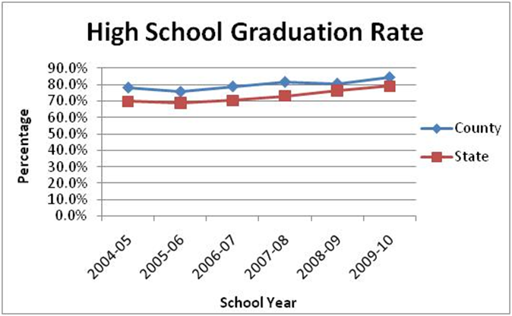
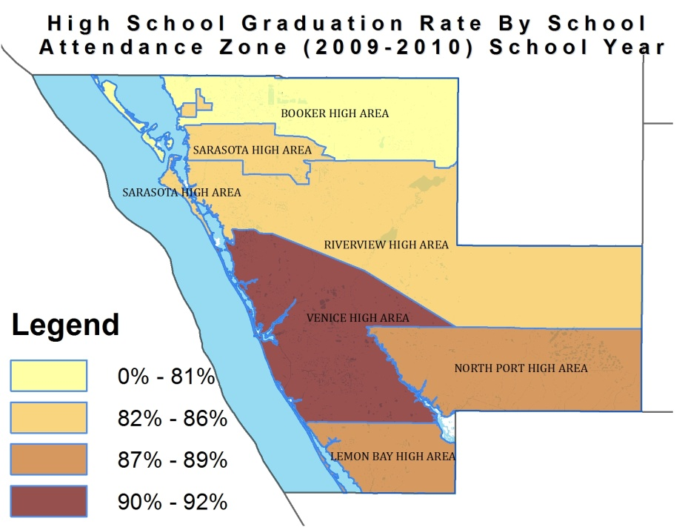
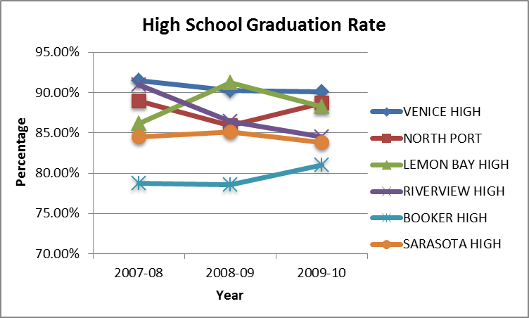
2010 Update – HS Graduation

Slide 16
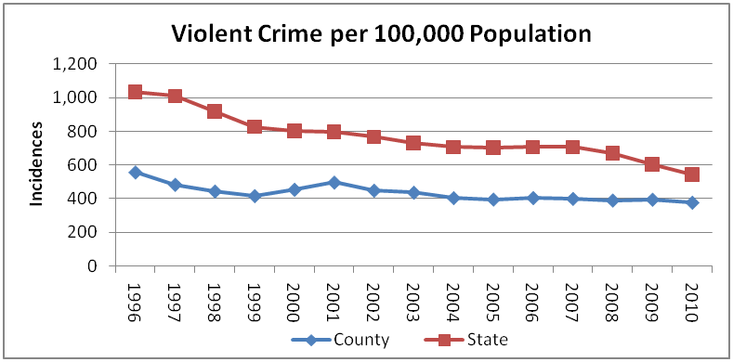
2010 Update – Violent Crime

Slide 17
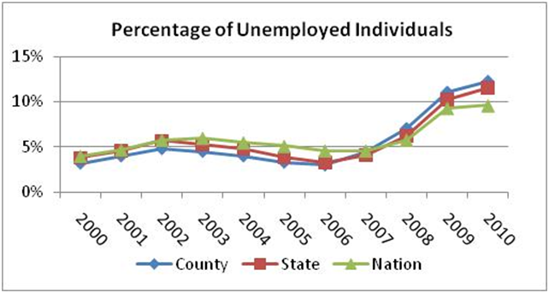
2010 Update – Unemployment

Slide 18
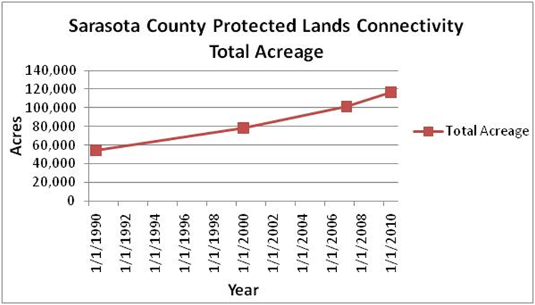
2010 Update – Protected Lands

Slide 19
2010 Update – Indicators
Demographics:
Total population*
Age : 65 years & older ; Under 18 years*
Race / Ethnicity: Black / African American; White; Hispanic / Latino*
Civic Well-Being:
Voter Registration *
Newspaper Circulation
Culture & Recreation:
Public Library Visits
Recreational Boating
Economic Well-Being:
Tourist Spending
Unemployment
Income Below Poverty Level
Health:
Low Birth Weight
Infant Mortality
Eating Fruits & Vegetables
Diabetes
Learning:
School Stability *
10th Grade Reading Achievement*
High School Absenteeism*
High School Graduation *
Natural Environment:
Connectivity of Local Protected Lands*
Fresh Water Consumption
Active Bald Eagle Nests*
Built Environment:
Housing Stock
Home Occupancy
Residential Permits Issued
Social Well-Being:
Domestic Violence
Violent Crime
Homelessness
Transportation: Motor Vehicle Usage
Public Transportation
Traffic Crash Fatalities

Slide 20
THE BIG QUESTIONS
As someone who lives and/or works in Sarasota County, what surprises you in the patterns revealed in these data?
Which patterns interest, concern or inspire you most?

