Slide 1
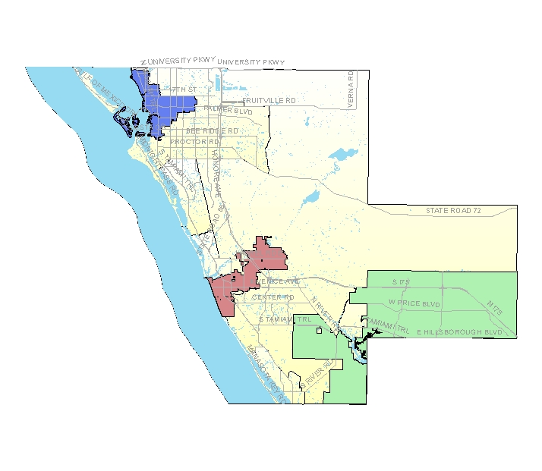
Community Data 2.0: North Port
A Community-Wide Rebooting
Co-hosted by SCOPE & The City of North Port
March 15, 2012
Morgan Family Community Center
North Port, Florida

Slide 2
Today’s Purpose
Greater awareness of local community data resources
Redefining desired community outcomes & ways to keep track
Identifying who’s in & what’s next

Slide 3
Agenda
8:00 -- 8:30 Breakfast & Networking
8:30 -- 9:00 Welcome & Introduction
9:00 -- 9:40 A GIS View of North Port & Sarasota County
9:40 -- 10:20 Home-Grown Community Data Efforts
10:20 – 10:30 BREAK
10:30 – 11:05 “Rebooting” with Questions re: Community Well-Being
11:05 – 11:45 What Next?
11:45 – 12:00 Concluding Remarks

Slide 4
Our Orientation
Community Data for
Community Change

Slide 5
Aspects of a Community Change Initiative
trusting relationships /
social capital /
sense of community
civic engagement
social
educational
neighborhood self-organizing capacity
physical environment
- built (e.g. housing)
- natural (e.g. parks)
community-building
programming / services
resident leadership
economic
community
well-being
mapping the “policy landscape”
data / evaluation
policy / systems
intentional change efforts
community-institutional partnerships
(& also unintentional)
overall community change initiative
fiscal allocations

Slide 6
Our Orientation
Community Data for
Community Change

Slide 7
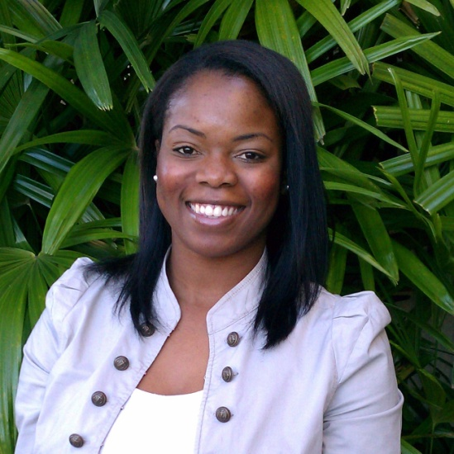
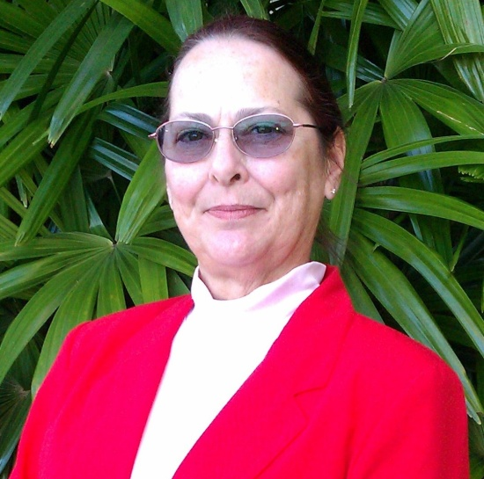
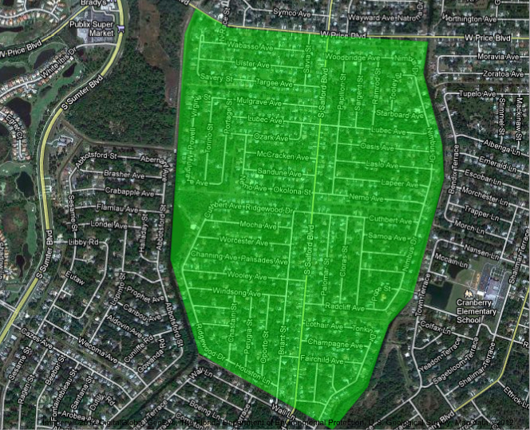
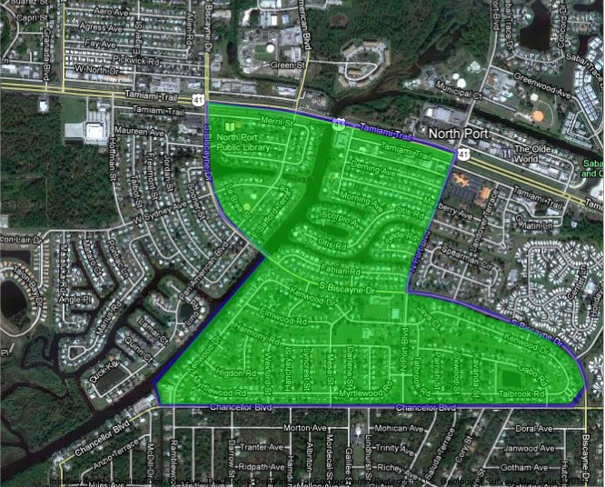
Resident-Led Community Changemaking

Slide 8
Resident-Led Community Changemaking

Slide 9
Resident-Led Community Changemaking

Slide 10
North Port of Sarasota County

Slide 11
THE BIG QUESTION
What inspired you to be a part of this community convening today?

