Slide 1
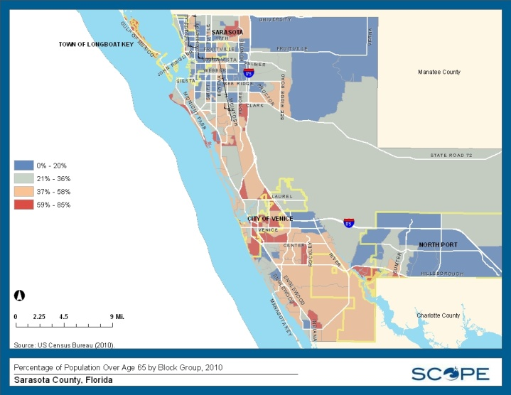
Community Data 2.0: An Older Adult Perspective
What Qualities of Life Matter Most?
Co-hosted by the Continuing the Conversation, Community Data Collaborative, ACE @ SCTI & SCOPE
August 24, 2012
Sarasota County Technical Institute, Sarasota, Florida

Slide 2
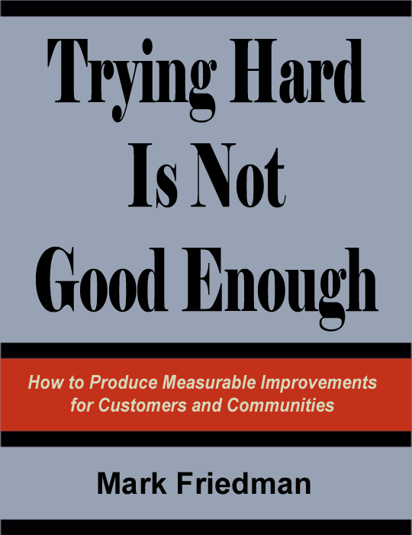
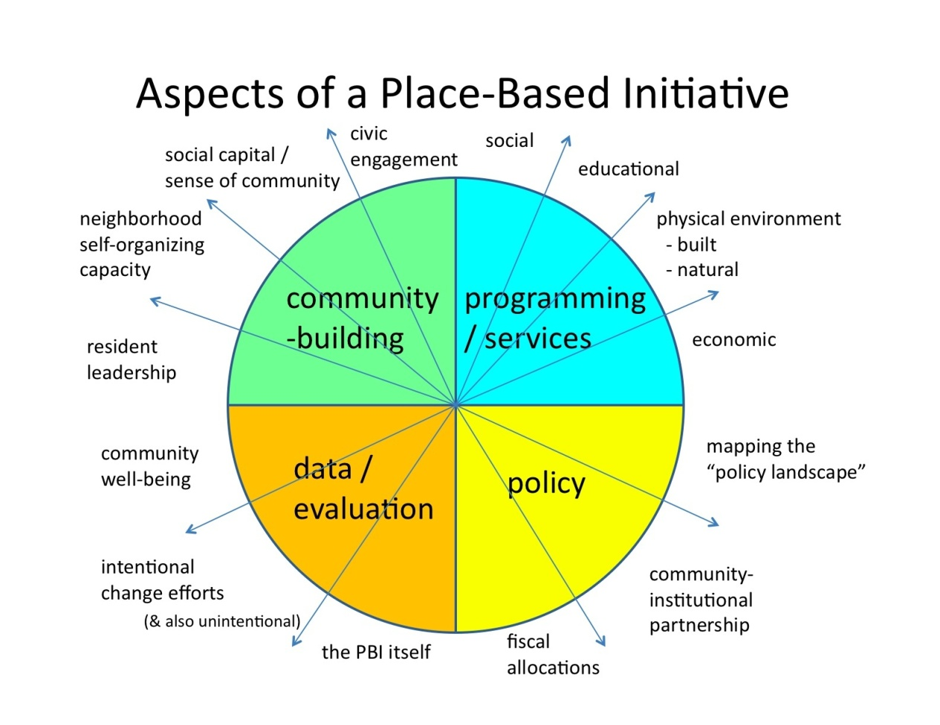
A Framework for Rebooting
A disciplined way of
thinking and taking action together
to improve the quality of life in communities &
to improve intentional efforts

Slide 3
Rebooting w RBA
THE BIG QUESTIONS
What are the qualities of life that matter most to children, adults, and families in Sarasota?
What would these qualities look like if we could see them?
How can we measure these qualities?

Slide 4
Rebooting w RBA
THE BIG QUESTIONS
What is your “Life is Good” moment
in Sarasota County?
What are the qualities of life that matter most to older adults in Sarasota?
What would these qualities look like if we could see them?
How can we measure these qualities?

Slide 5
Rebooting w RBA
What is your “Life is Good” moment in Sarasota?

Slide 6
What is your “Life is Good” moment here in Sarasota County?
Michael

Slide 7
What is your “Life is Good” moment here in Sarasota County?
Caryl

Slide 8
THE BIG QUESTIONS
What is your “Life is Good” moment
in Sarasota County?
relating to older adults
What are the qualities of life that matter most to older adults in Sarasota?
What would these qualities look like if we could see them?
How can we measure these qualities?

Slide 9
Review of County-Scale Community Indicators
Notes:
OK, so now, equipped with the GIS Profile of North Port, the “Deck of Cards,” the Summary of Indicators & the Total list of indicators, consider the following…

Slide 10
Older Adult Related Community Indicator Resource
http://successfulaging.milkeninstitute.org

