Slide 1
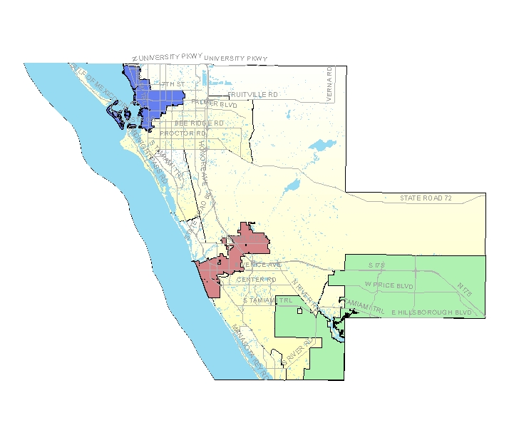
Community Data 2.0
Now What?
Hosted by SCOPE
May 19, 2011
Gulf Coast Event & Conference Center
Sarasota, Florida

Slide 2
Challenges of…
Identifying qualities & indicators particular to our community
Increasing openness / exchange of data
Increasing usefulness of data
Increasing reflection upon data & action
A Community Data Collaborative?

Slide 3
THE BIG QUESTION
Why not?

Slide 4
A RELATIVELY LOCAL EXAMPLE
http://psrdc.fmhi.usf.edu/pinellas.html

Slide 5
Now, a Conversation Around
Core Questions
Datasets / Data Stewards
Technologies
Engagement & the Fun Factor
Other

Slide 6
THE BIG QUESTIONS
Who needs to be a part?
What would you & others DO next?
What else needs to exist or happen?

