Slide 1
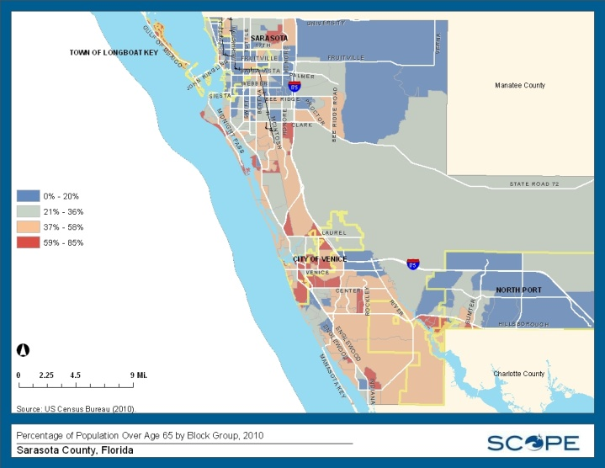
Community Data 2.0: An Older Adult Perspective
What’s Going on Around Here
to Make Things Even Better?
Co-hosted by the Continuing the Conversation, Community Data Collaborative, ACE @ SCTI & SCOPE
August 24, 2012
Sarasota County Technical Institute, Sarasota, Florida

Slide 2
What’s Going on Around Here to Make Things Even Better? Learning: Libraries

Slide 3
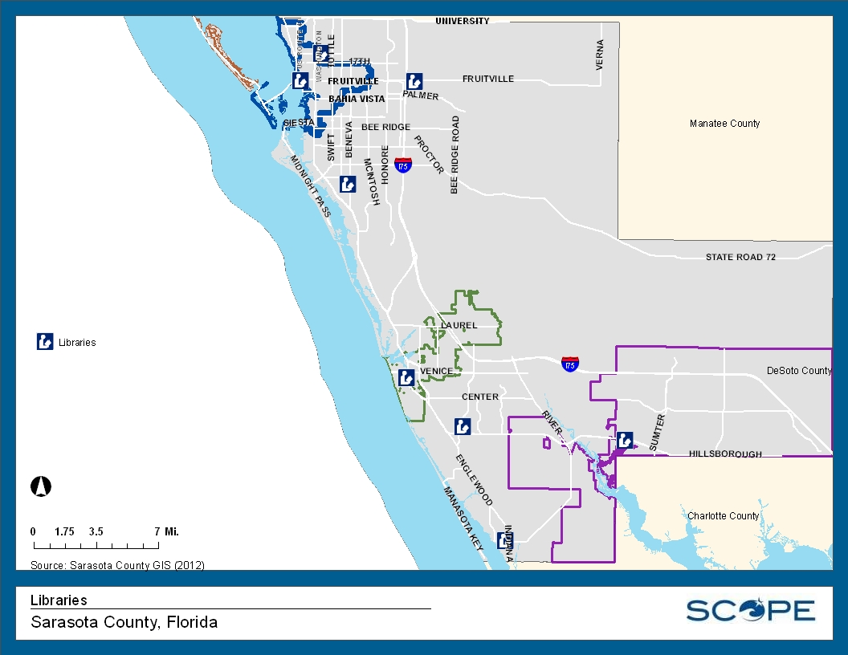
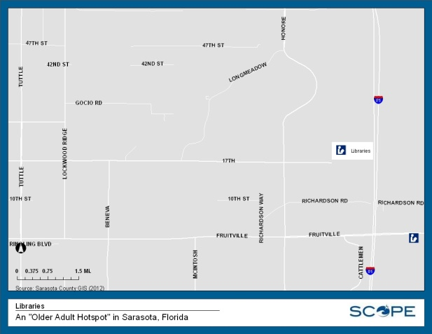
What’s Going on Around Here to Make Things Even Better? Learning: Libraries

Slide 4
What’s Going on Around Here to Make Things Even Better? Learning: ACE Partner Institutions

Slide 5
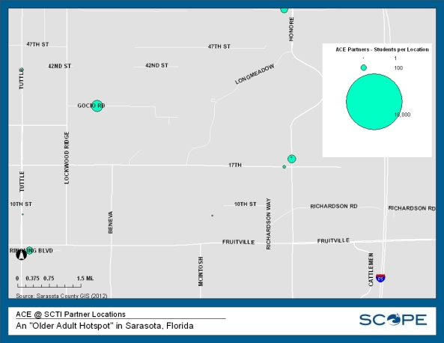
What’s Going on Around Here to Make Things Even Better? Learning: ACE Partner Institutions

Slide 6
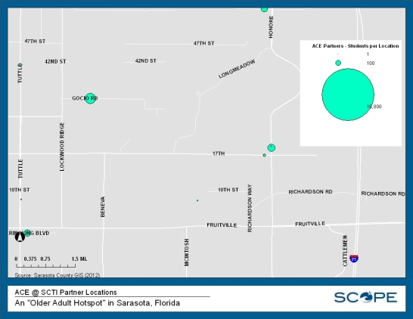
What’s Going on Around Here to Make Things Even Better? Learning: ACE Partner Institutions

Slide 7
What’s Going on Around Here to Make Things Even Better? Learning: CtC Workgroup Meetings

Slide 8
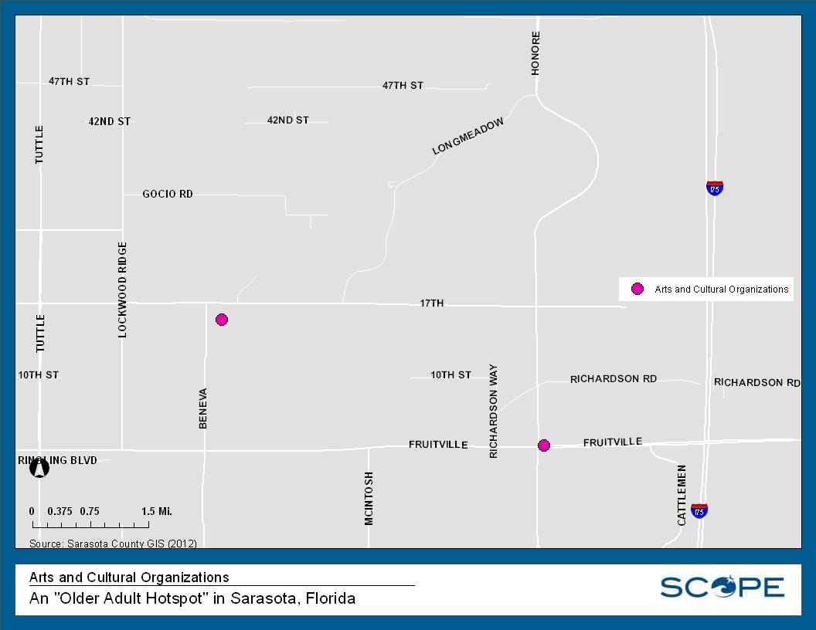
What’s Going on Around Here to Make Things Even Better? Culture & Recreation: Arts & Cultural Organizations

Slide 9
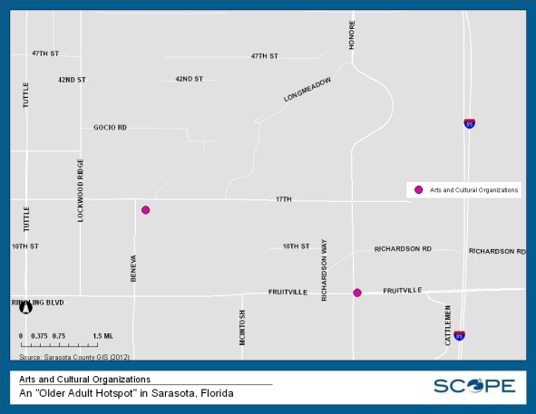
What’s Going on Around Here to Make Things Even Better? Culture & Recreation: Arts & Cultural Organizations

Slide 10
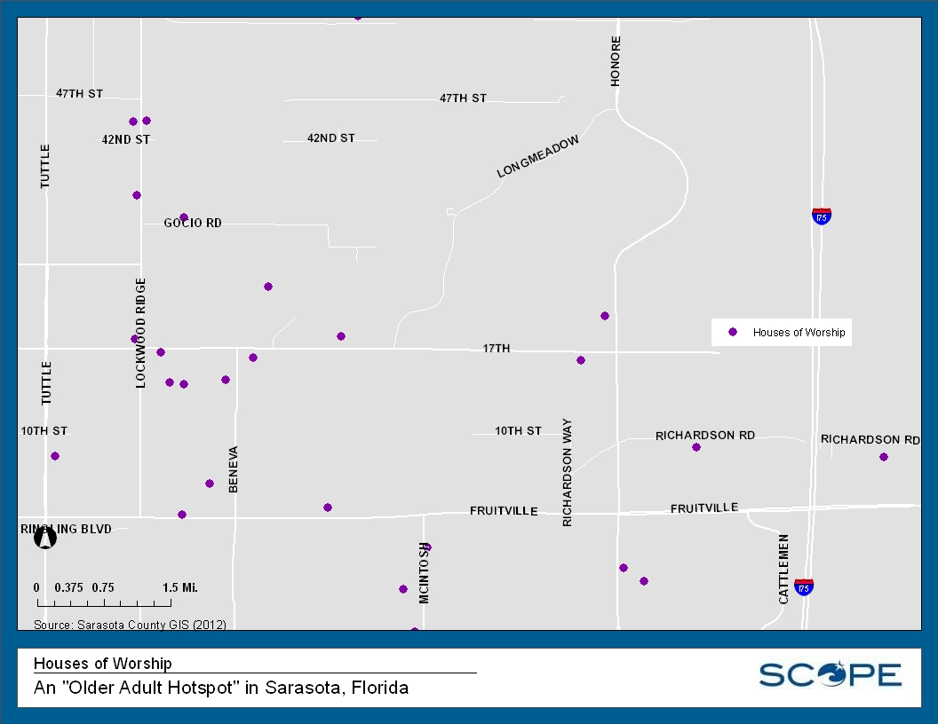
What’s Going on Around Here to Make Things Even Better? Culture & Recreation: Houses of Worship

Slide 11
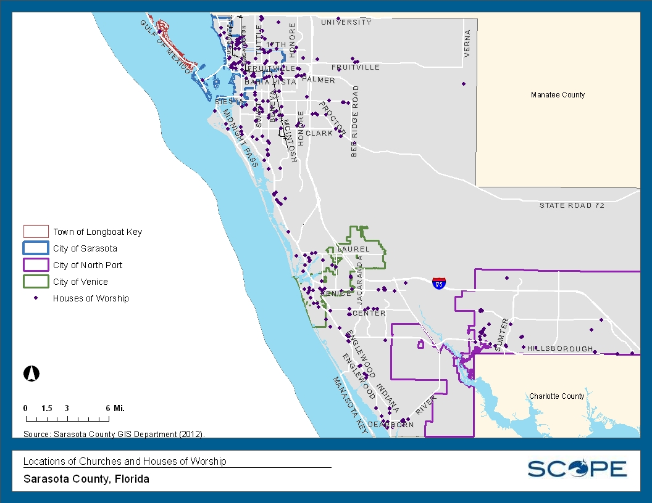
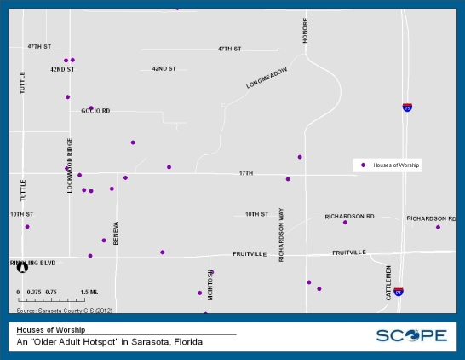
What’s Going on Around Here to Make Things Even Better? Culture & Recreation: Houses of Worship

Slide 12
What’s Going on Around Here to Make Things Even Better? Natural & Built Environment: Parks

Slide 13
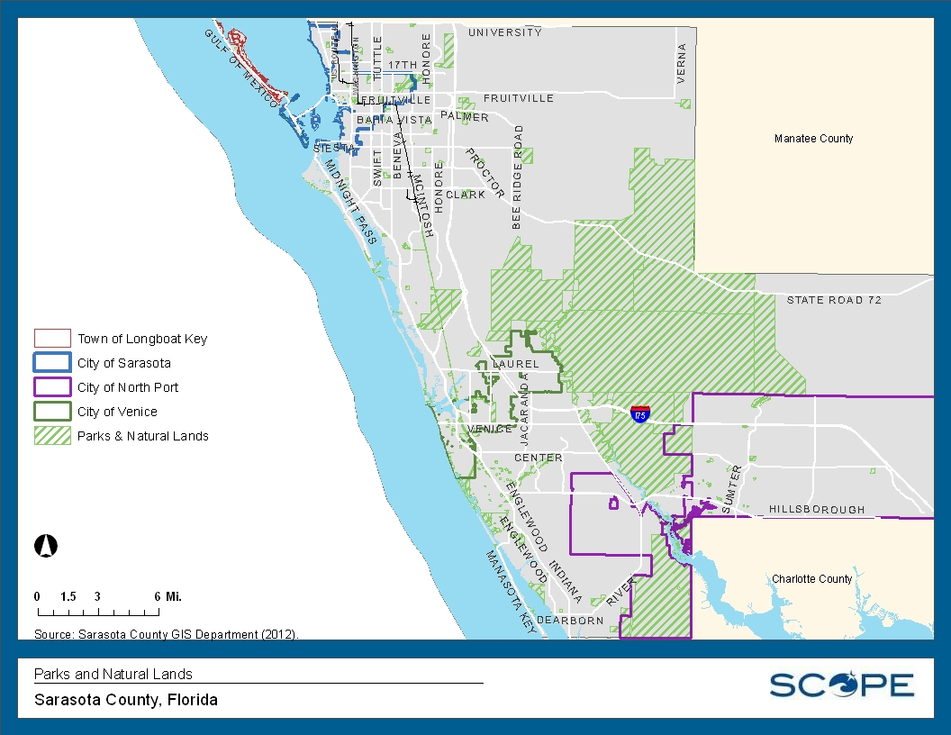
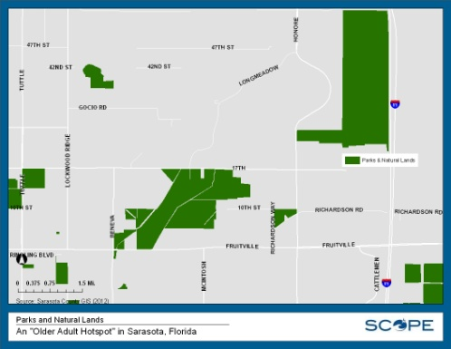
What’s Going on Around Here to Make Things Even Better? Natural & Built Environment: Parks

Slide 14
What’s Going on Around Here to Make Things Even Better? Health: Healthcare Sites

Slide 15
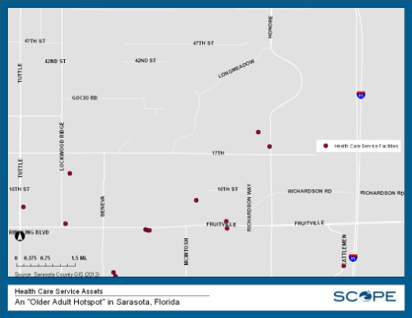
What’s Going on Around Here to Make Things Even Better? Health: Healthcare Sites
Notes:
The Health and Medical Feature Class stores the folllowing health related facilities: Health or Medical Facility Blood Bank Center for Disease Control Office Day Care Facility Diagnostic Laboratory Homeless Shelter Hospital Medical Research Laboratory Medical Stockpile Facility Morgue Mortuary / Crematory Nursing Home Walk-In Clinic Pharmacy Public Health Office Rehabilitation Center Relief Agency / Facility Crisis Center Assisted Living Facility Medical Center Adult Day Care Facility

Slide 16
What’s Going on Around Here to Make Things Even Better? Transportation: Independent Transportation Network

Slide 17
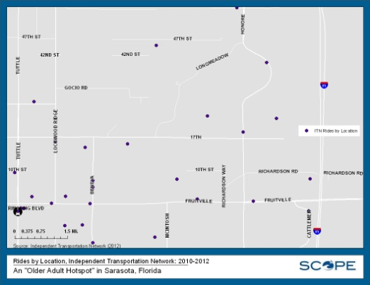
What’s Going on Around Here to Make Things Even Better? Transportation: Independent Transportation Network

Slide 18
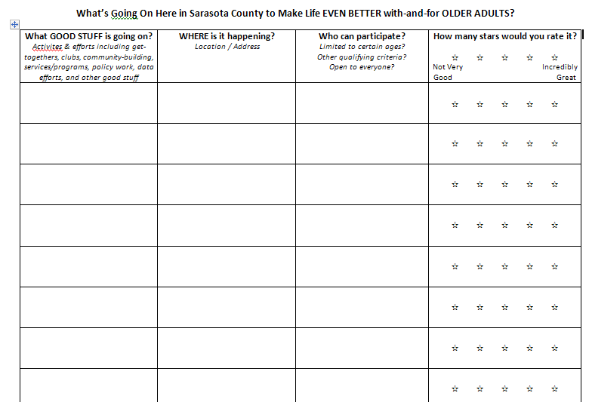
To Discuss in Small Groups
What do YOU know is going on to make things even better here, with-and-for older adults?

