Slide 1
Monthly Meeting
April 24, 2012

Slide 2
Agenda
I. Welcome/Introductions
II. Review/Approval of Meeting Notes
III. What is a Collaborative? – Tim Dutton
IV. Datasets & Data Stewards
V. Platform and Technologies
VI. Announcements

Slide 3
Datasets & Data Stewards
Discussion: What does it mean to be a Collaborative? Who’s in?

Slide 4
Datasets & Data Stewards
Discussion: Data Collaborative Purpose and Agreement of Understanding

Slide 5
Datasets & Data Stewards
Datasets:
Discussion of Arrest Data
SCOPE working to contribute “Life is Good” videos to platform next month

Slide 6
Platform & Technologies
Open Green Map Launch: need assistance from Data Collaborative
Update on Community Platform
Urban Institute continuing to work on requested changes
Dashboard Module in Development
Drawing neighborhood polygons

Slide 7
Neighborhood Dashboard

Slide 8
Neighborhood Dashboard

Slide 9
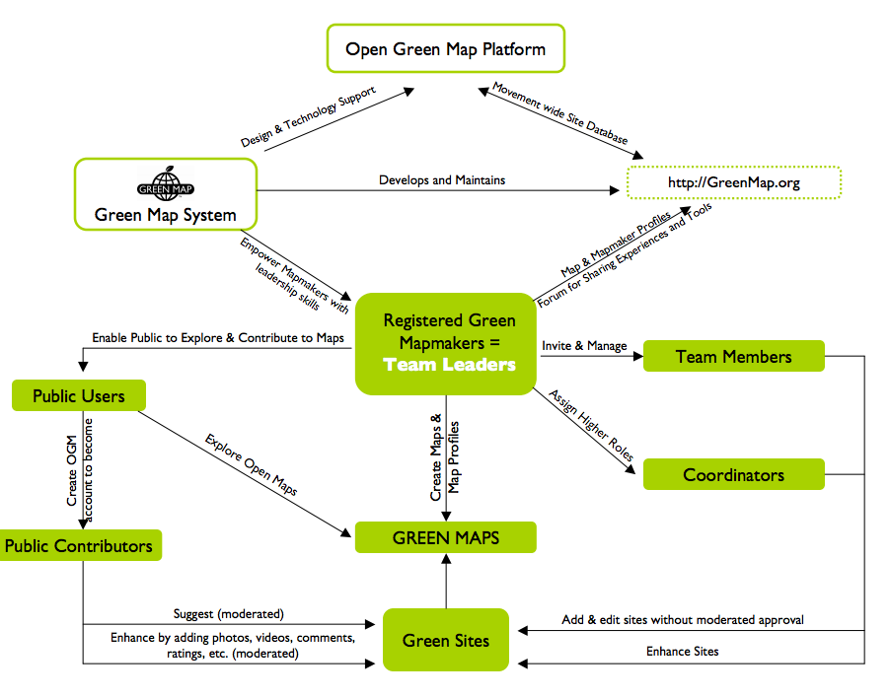
Platform User Roles: OGM

Slide 10
Final Announcements
Thank you, Health Department
Next meeting: May 22, 10am
location?
Other announcements?

Slide 11
Developing a Community Data Collaborative
Online Gathering of Perspectives
Data Stewards Group Meetings
In-person Convenings
(Other)
Quality of Life Indicators
Datasets
&
Stewards
1:1 with Data Stewards
Data 2.0 Sessions
Reflection for
Decision-Making
Platform
&
Technologies
Online Community Platform
Residents
Institutions / Sectors
Synching with other local resources / technologies
Notes:
In the interest of maintaining continuity, we’ve built the agenda around this framework so that we have to ability to touch all quadrants in our conversations.

