Slide 1
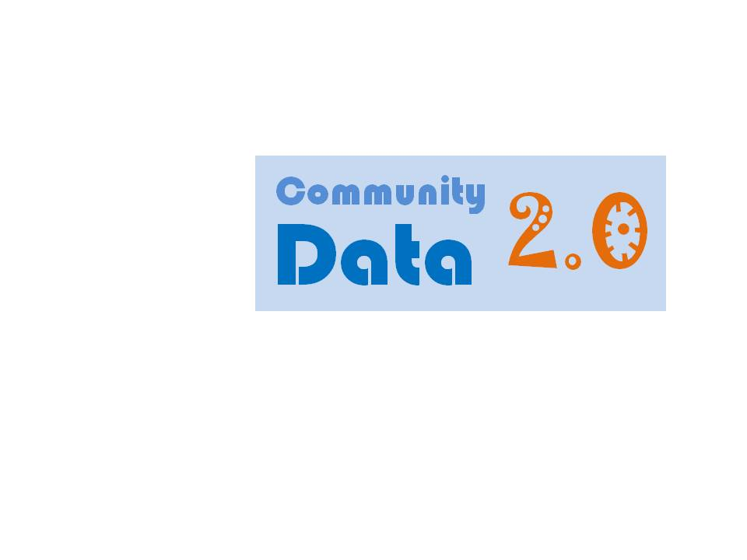
An Opportunity for Collaboration
SCOPE Presentation to North Port Commission
September 12, 2011

Slide 2
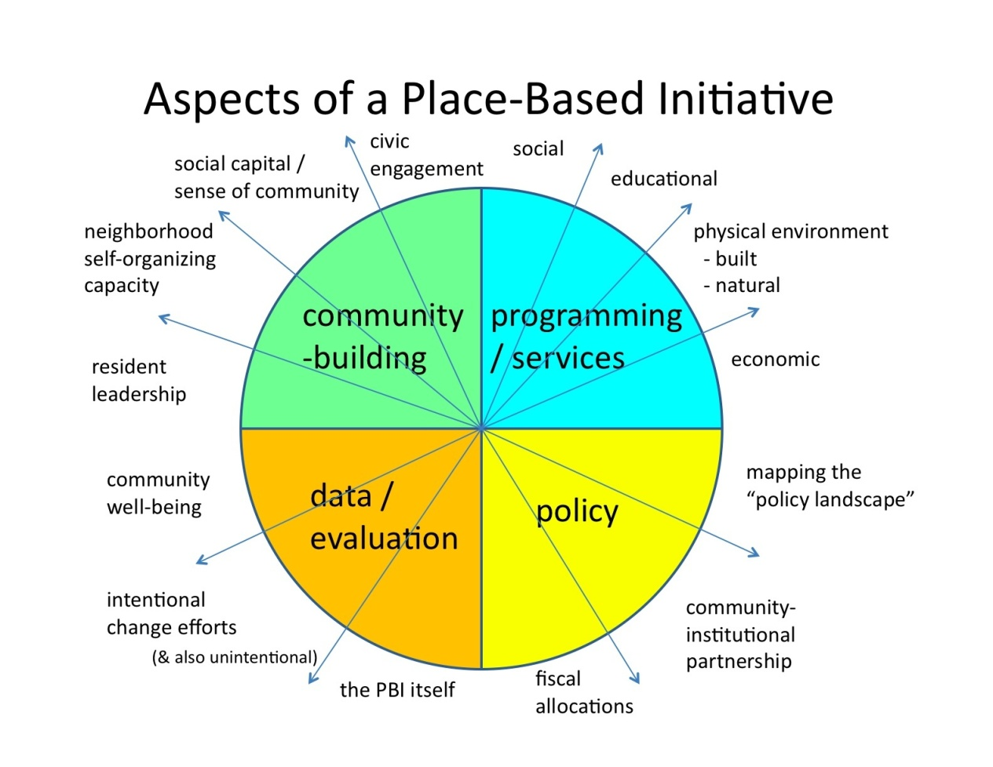
The What & Why of Community Data
To clarify local, present-day realities.
To continually reflect together for:
Sense-making
Decision-making
Action
“Community Data for Community Change.”
Notes:
To clarify & reflect upon local, present-day realities. In these ways, our community has been able to better identify next steps and take action for positive change.

Slide 3
Features & Benefits of High Quality Data
Features
Granular
Frequent
Citizen-Centric
Benefits
Preventing overgeneralization
Keeping up with the pace of change
Acknowleding primary locus of control
Notes:
To clarify & reflect upon local, present-day realities. In these ways, our community has been able to better identify next steps and take action for positive change.

Slide 4
Composite GIS Map
Boundaries:
Census Tract / Block Group / Block
Zip Codes
School Attendance Zones
Voting Precincts
Neighborhood & Homeowner’s Associations
Demographics:
Total #
Age: Over 65 Years, Under 18 Years, Under 5 Years
Race / Ethnicity: Black / African-American, Hispanic / Latino, White
Households: Owners/Renters, with Kids, with Single Individuals
Assets:
Libraries
Churches
Firehouses
Parks
Schools
Businesses
Neighbor-Identified Assets
Indicators of Well-Being:
Civic Participation
Culture & Recreation
Economy
Health
Learning
Environment
Social

Slide 5
A North Port Example
Boundaries:
Census Tract / Block Group / Block
Zip Codes
School Attendance Zones
Voting Precincts
Neighborhood & Homeowner’s Associations
Demographics:
Total #
Age: Over 65 Years, Under 18 Years, Under 5 Years
Race / Ethnicity: Black / African-American, Hispanic / Latino, White
Households: Owners/Renters, with Kids, with Single Individuals
Assets:
Libraries
Churches
Firehouses
Parks
Schools
Businesses
Neighbor-Identified Assets
Indicators of Well-Being:
Civic Participation
Culture & Recreation
Economy
Health
Learning
Environment
Social

Slide 6
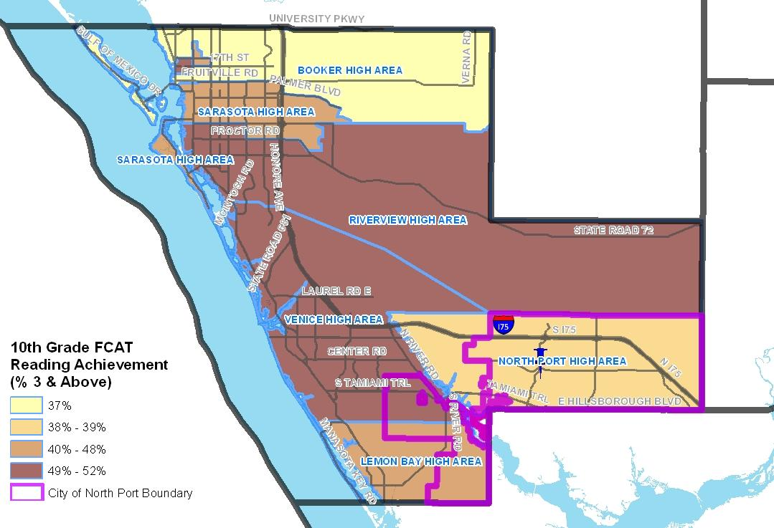

Slide 7
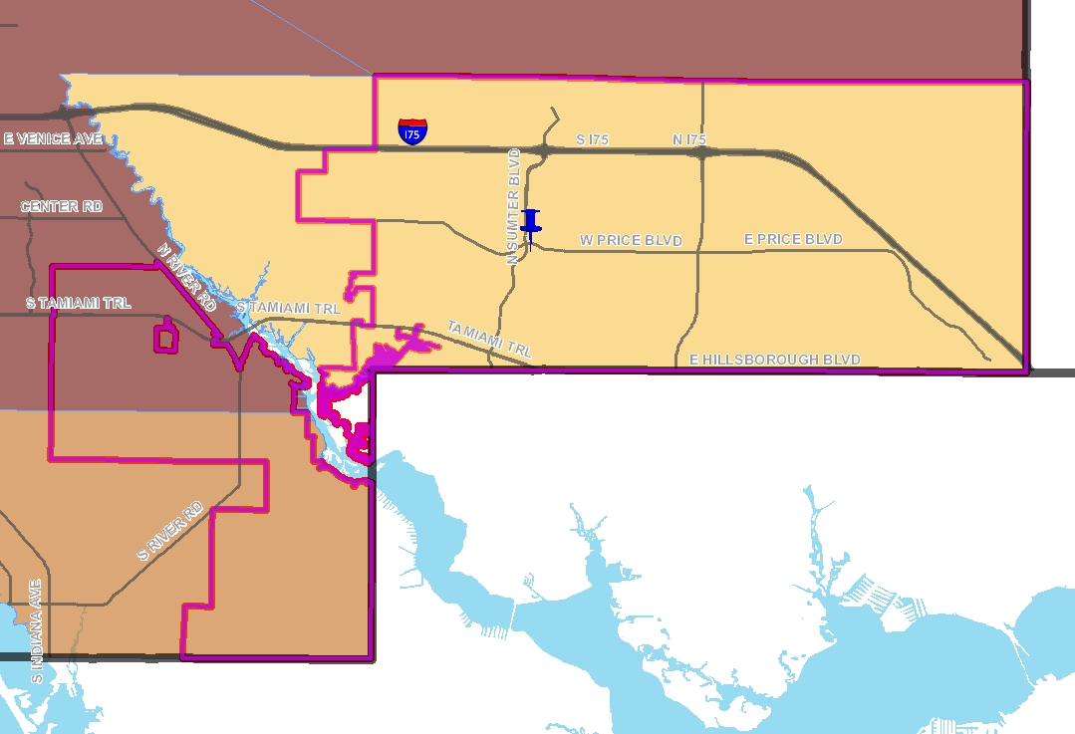

Slide 8
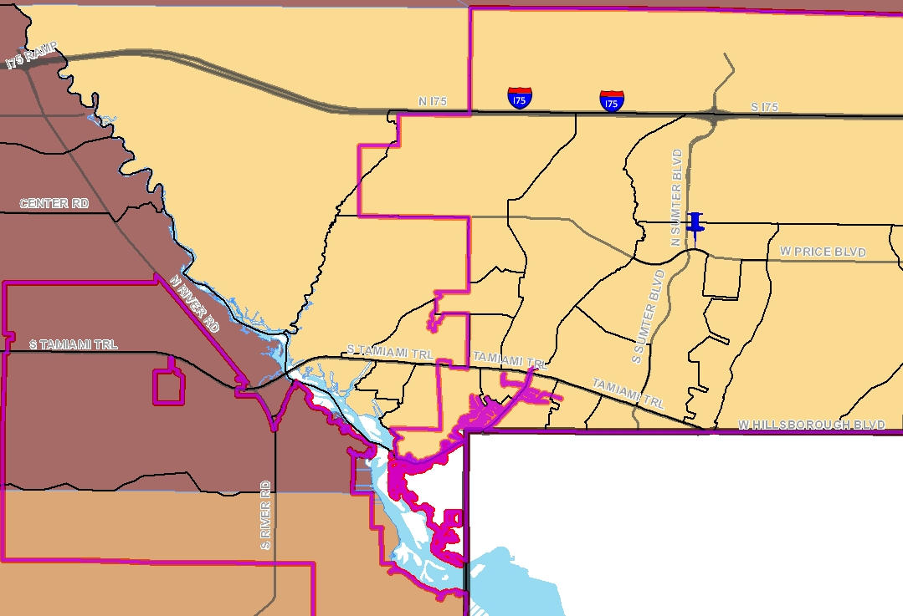

Slide 10
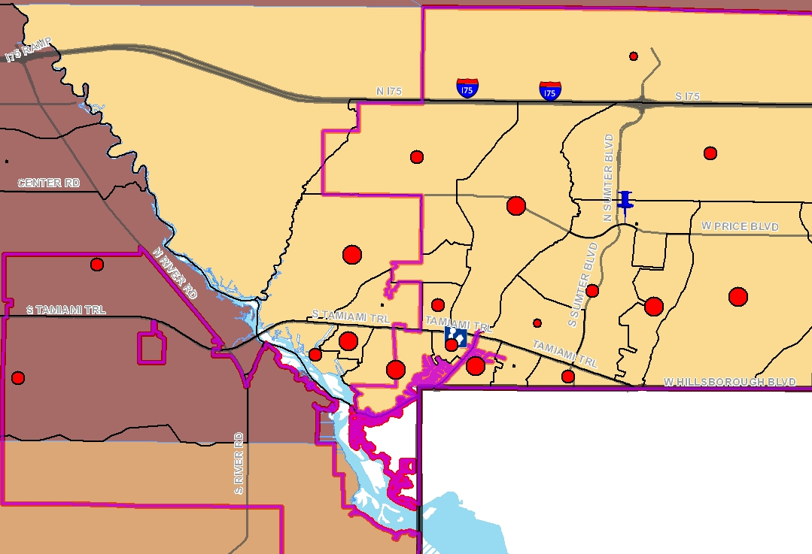

Slide 12
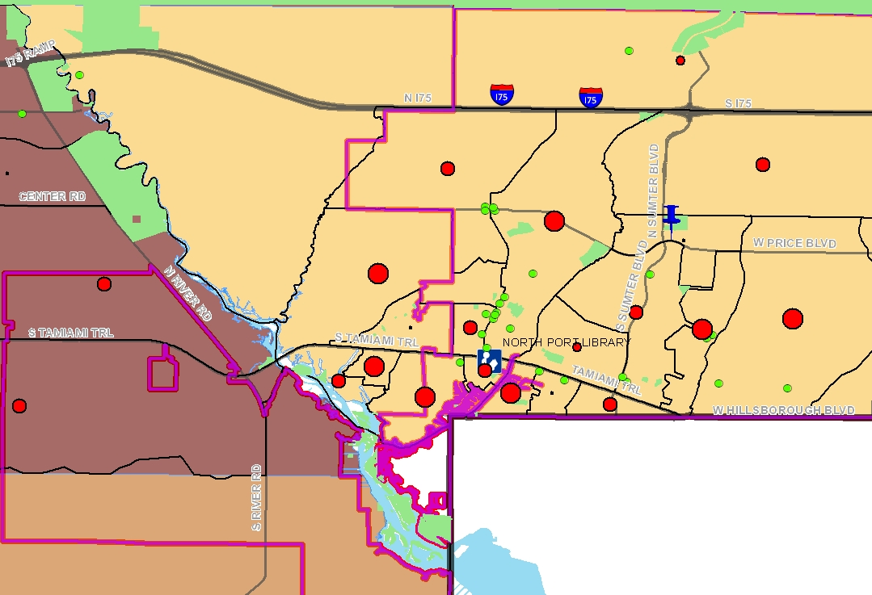

Slide 13
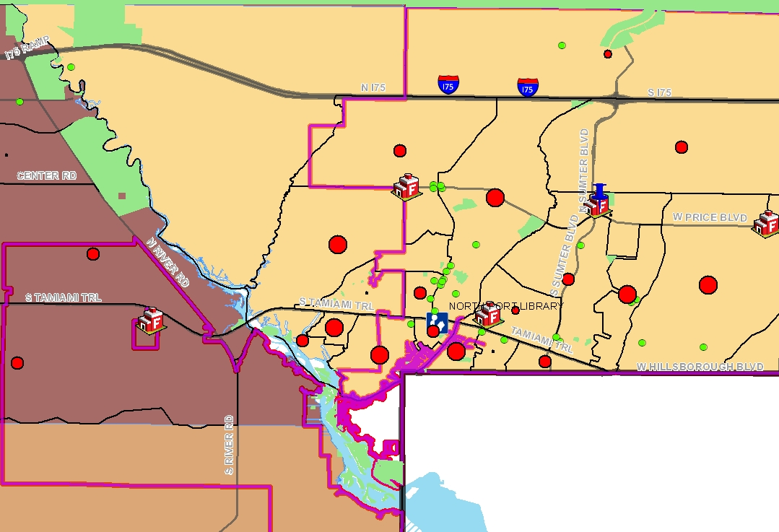

Slide 15
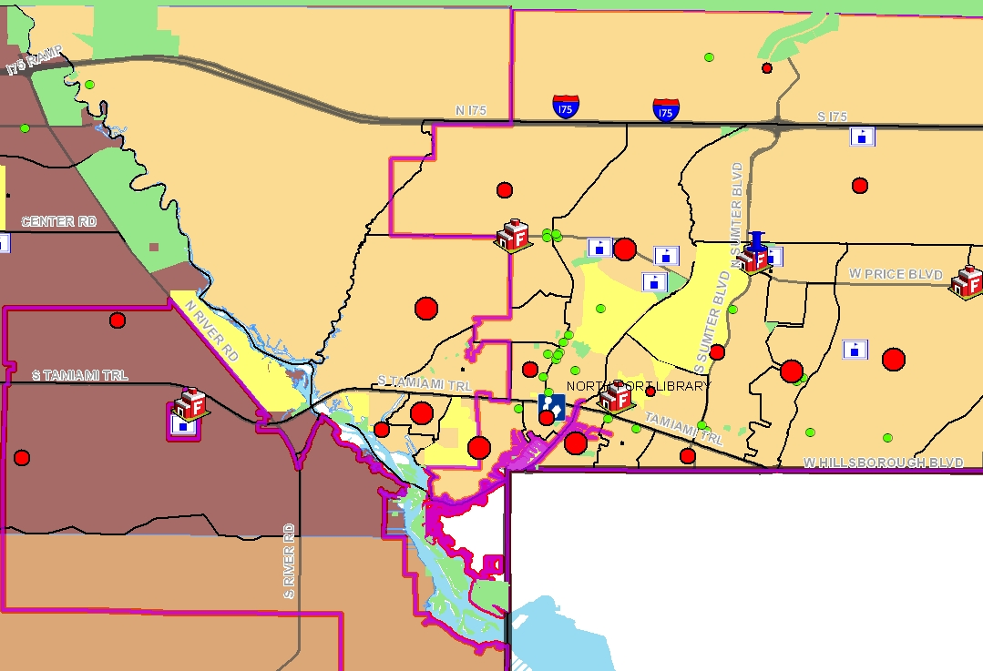

Slide 16
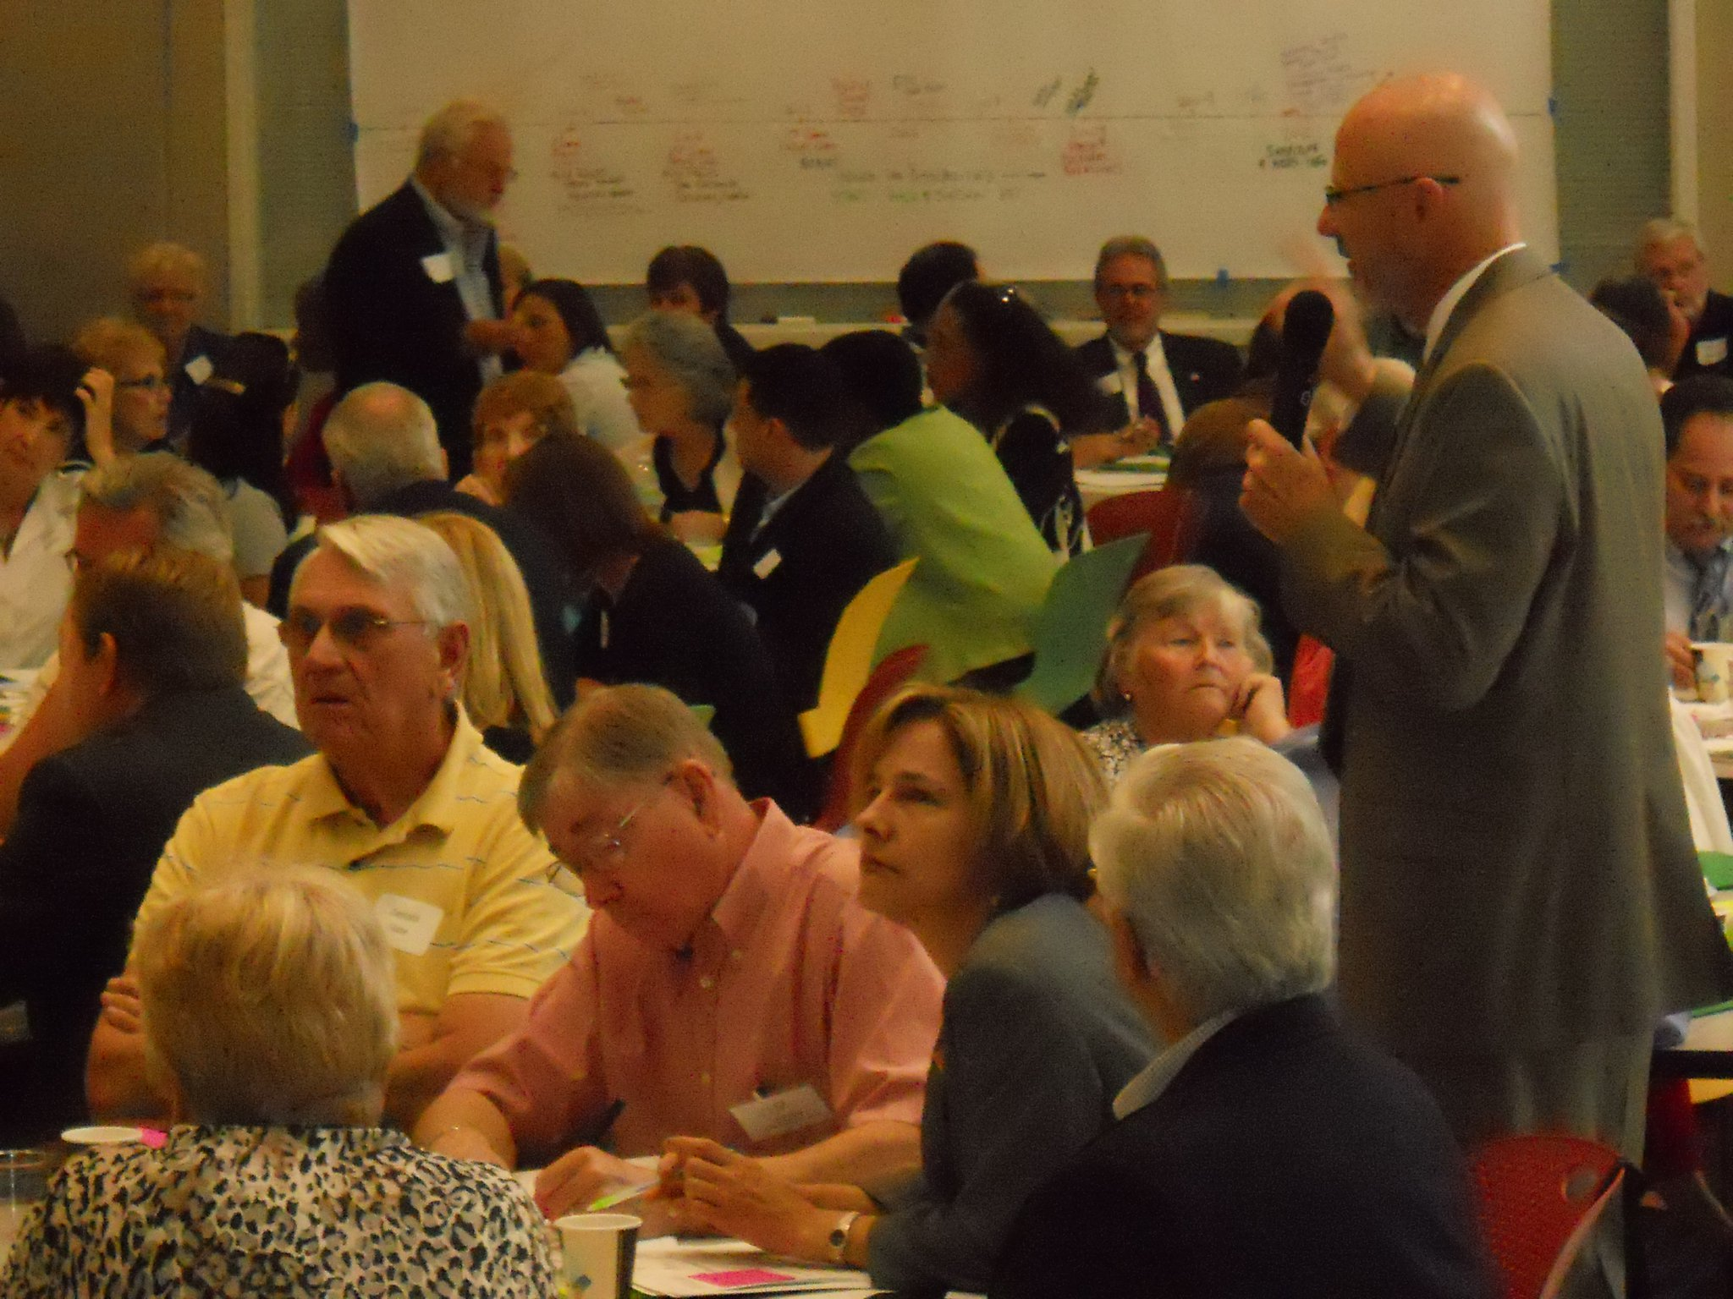
An Update on Community Data 2.0: The May 19 County-Wide Session

Slide 17
Data 2.0 Convening - Participants
Neighborhoods | Central-Cocoanut, Plymouth Harbor
Government | Sarasota County: Commissioners; Departments of Sustainability, Health & Human Services, & Libraries; City of Sarasota: Neighborhood Services, Newtown Redevelopment, Information Technology; City of North Port
Media | Sarasota Herald-Tribune, WSLR
Education | Sarasota County School District, Ringling, New College, USF, University of Florida, Argosy
Non-Profit Organizations & Related Networks | YMCA, Community Youth Development, Senior Friendship Centers, Girls Inc., Suncoast Partnership to End Homelessness, Sarasota Partnership for Children’s Mental Health, Independent Transportation Network, SCOPE, SCORE, Jewish Family and Children’s Services, Multicultural Health Institute, Argus Foundation, Sarasota Convention & Visitors Bureau, Collins Center
Private Business | DwellGreen, Osborn Sharp Associates, Michael Saunders & Company, ReMax Alliance Group, Avastone Consulting, Arox Land Development, Banyan Sprout
Economic Development | Sarasota County Economic Development Corp., Venice Chamber of Commerce
Philanthropy | Community Foundation of Sarasota County, Gulf Coast Community Foundation, Selby Foundation, Van Wezel Foundation
Notes:
Most of the crowd came from non-profit organizations and government entities, but people from neighborhood groups, media, education, private businesses, economic development organizations and philanthropic organizations attended as well.

Slide 18
Data 2.0 Convening - Questions
Engagement | What inspired you to be a part of this community convening today?
Existent Indicators that Matter | As someone who lives and/or works in Sarasota County, what surprises you in the patterns revealed in these data? Which patterns interest, concern or inspire you most?
Innovations | What other local innovations do you know about? How do you expect you could make the most of these innovations, as a resident and as a professional?
Qualities of Well-Being that Matter | What are the qualities of life that children, adults, and families in our community want?
Everyday Evidence | What would these qualities look like if we could see them?
Proposed Indicators | How can we measure these qualities?
Next Steps | Regarding: Core Questions, Datasets / Data Stewards, Technologies, Engagement & Other: Who needs to be a part? What would you & others DO next? What else needs to exist or happen?

Slide 19
Data 2.0 Convening - Questions
Total of 160 participants + 5 SCOPE staff members
Notes:
165 people attended the Data 2.0 event of which 88% responded they live in Sarasota County and 92% responded they worked in Sarasota County.
There were 165 people who attended the Data 2.0 Event, and while there were a few from North Port, Venice, Englewood, and Sarasota County east of 75, the overwhelming majority of participants live and work in the City of Sarasota.

Slide 20
Partnership Opportunities for Consideration
Contributing Data
Co-founding a Community Data Collaborative

Slide 21
“It is a pivotal time. We need to be change-makers – and very capable ones at that.”
“How can we be more than just anxious critics of the status quo or wishful thinkers about a better future, and become actual and effective agents for large-scale transformation?”
“We believed that ways of seeing could change ways of doing.”
Getting to Maybe: How the World is Changed.
Westley, Zimmerman & Patton. (2006).

Slide 22
Community Data 2.0 Questions
Engagement | What inspired you to be a part of this community convening today?
Existent Indicators that Matter | As someone who lives and/or works in Sarasota County, what surprises you in the patterns revealed in these data? Which patterns interest, concern or inspire you most?
Innovations | What other local innovations do you know about? How do you expect you could make the most of these innovations, as a resident and as a professional?
Qualities of Well-Being that Matter | What are the qualities of life that children, adults, and families in our community want?
Everyday Evidence | What would these qualities look like if we could see them?
Proposed Indicators | How can we measure these qualities?
Next Steps | Regarding: Core Questions, Datasets / Data Stewards, Technologies, Engagement & Other: Who needs to be a part? What would you & others DO next? What else needs to exist or happen?
Notes:
One sentence describing this process of asking questions & its purpose.

Slide 23
Community Data – First Yield

Slide 24
Community Data – First Yield

Slide 25
Community Data – First Yield

Slide 26
Community Data – First Yield

Slide 27
Community Data – First Yield

Slide 28
Making a Case for:
Updating Community Indicators
Initiating process with core “reboot” question: “What are the qualities of life that children, adults, and families in our community want?”
Harnessing everyday wisdom (not just professional expertise)
Notes:
“Not everything that can be measured matters, and not everything that matters can be measured.” - Einstein

Slide 29
What Next?
Convening around the Core Reboot Question
With residents
With identity groups (e.g. age, ethnicity, culture)
With professional networks / sectors
In person & virtually
Gathering & Sharing Local Data
Key Data Partners: Sheriff’s Dept, School Dist, County, 211
Composite GIS Map
Community Platform (Possibility of Beta Site w/ Urban Institute)
Facilitating Ongoing Community Reflection
Across Sectors
Across Scales

Slide 30
“It is a pivotal time. We need to be change-makers – and very capable ones at that.”
“How can we be more than just anxious critics of the status quo or wishful thinkers about a better future, and become actual and effective agents for large-scale transformation?”
“We believed that ways of seeing could change ways of doing.”
Getting to Maybe: How the World is Changed.
Westley, Zimmerman & Patton. (2006).

